Slide 1



Ergo-tech
Equifax Hackathon 2017
Behnam Rasoolian PhD Candidate, Industrial Engineering
Rong Huangfu PhD Candidate, Industrial Engineering
Mengdie Chen Master of Business Administration and Finance Student
Bob Granzow PhD Candidate, Industrial Engineering

Slide 2
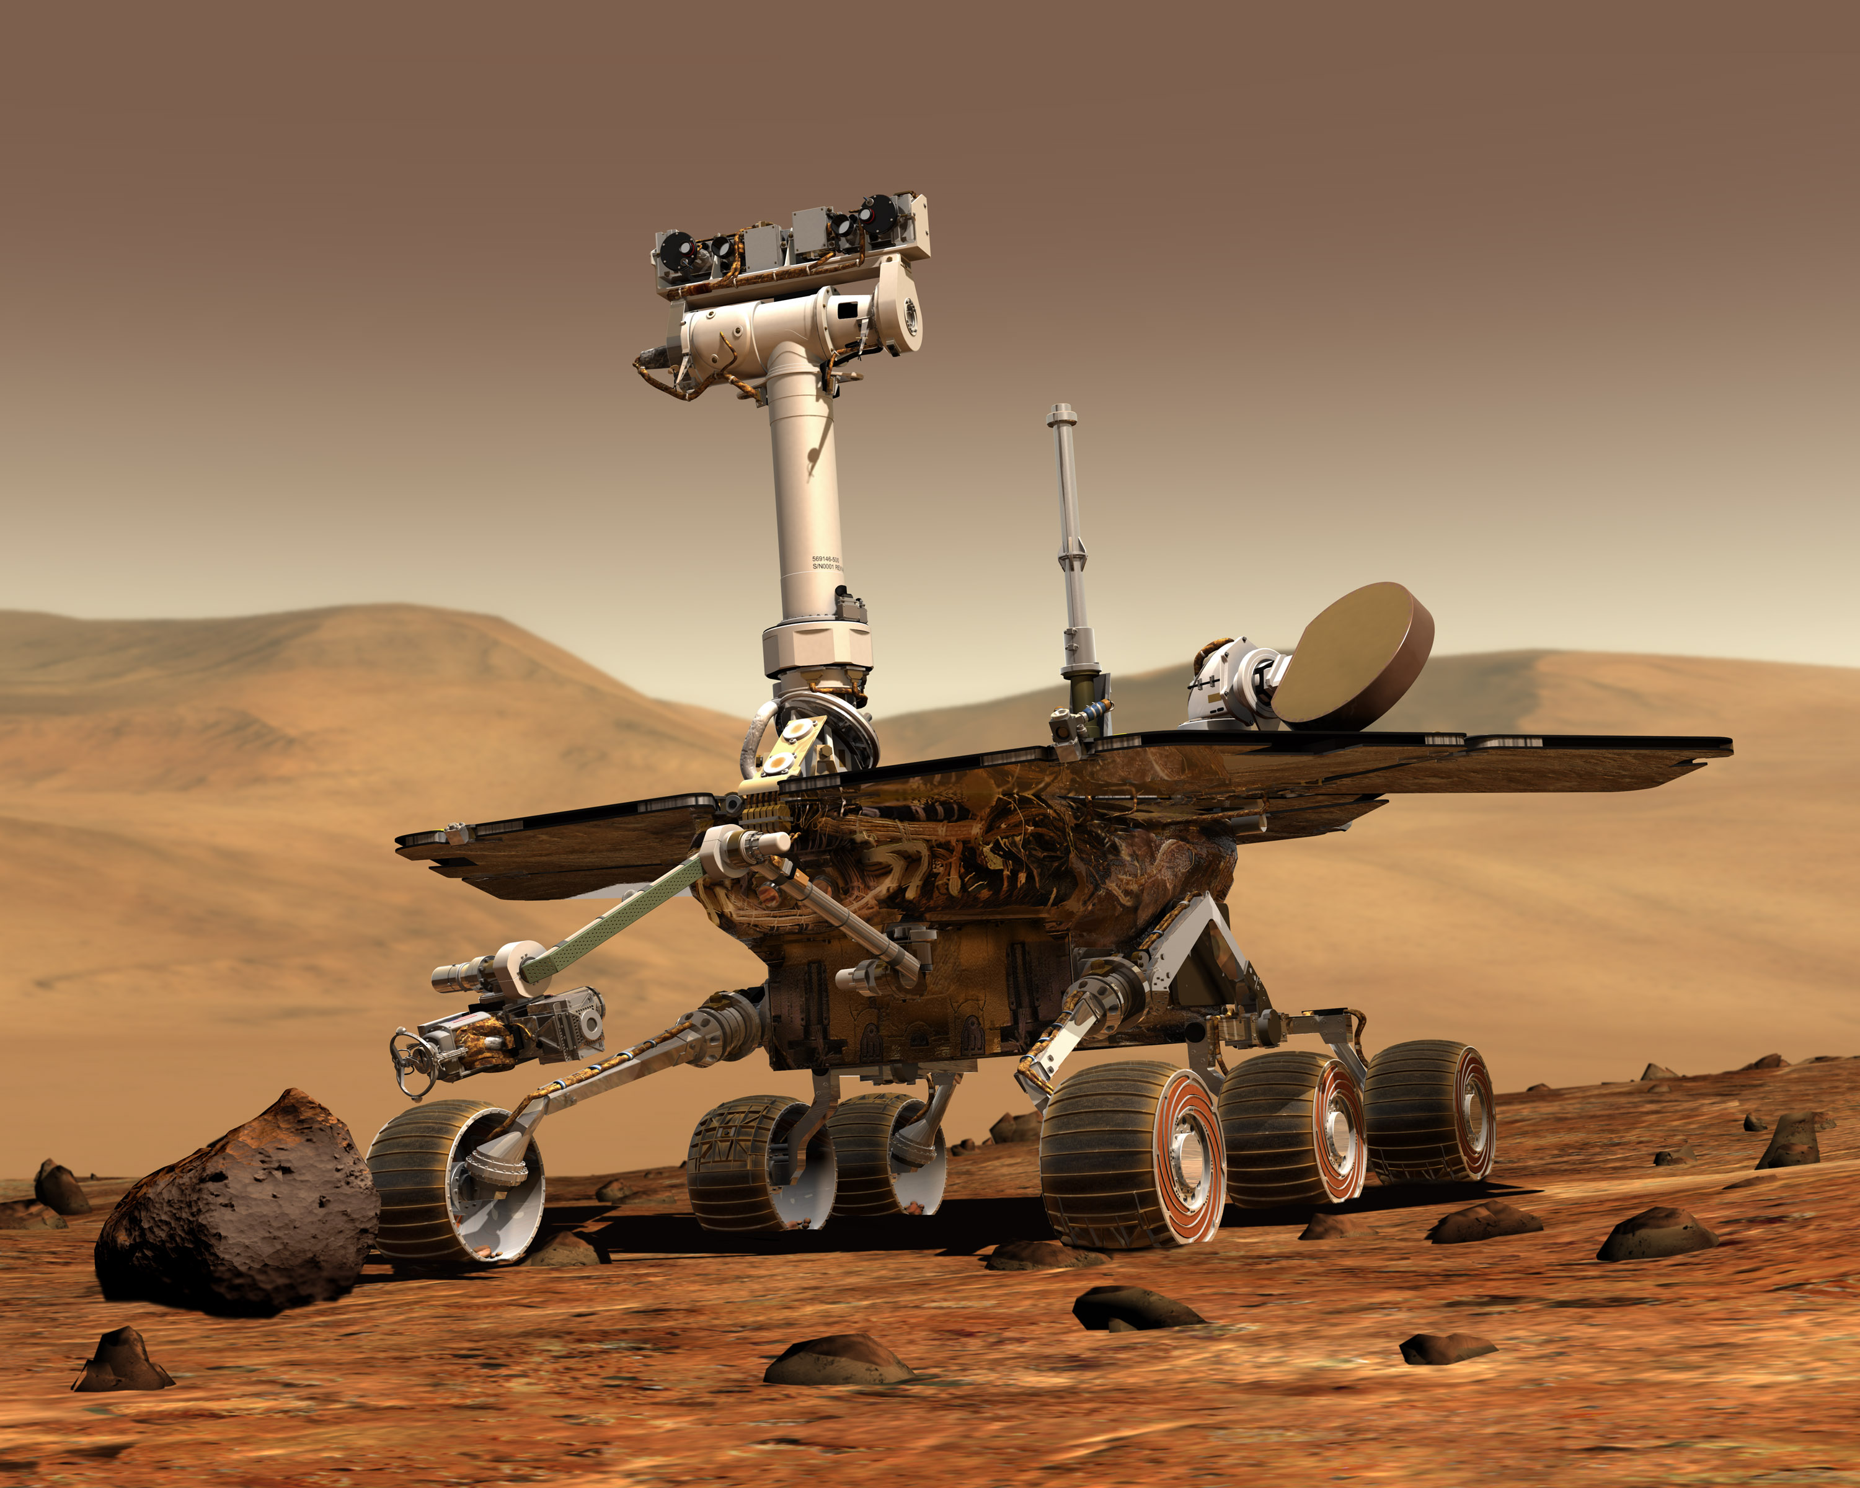
Ergo-Tech Approach
Setup server on Raspberry Pi
Host website and database
Developed MySQL database
For a given rover and camera, what dates have images (and quantity)
URL of 1st image to be used as preview
This is used to identify the dates that images are available for given rover and camera
Eliminates unnecessary query time for cameras or dates that have no images
Developed user interface (Python, PyQt)
Choose rover
Choose camera
Choose date (from available)
Displays pictures

